Slide 1
Time Domain Analysis of
Control Systems
Chapter 3

Slide 2
Review
Stability
  Stability condition
  Routh-Hurwitz criterion
Steady-state performance
  Definition of time response;
  Typical test signals;
  Performance specifications of steady-state response – steady-state error;
  Impact of disturbance to steady-state error;
  Impact of parameter variation to steady-state error.
Transient Response
  Performance Criteria
  Transient Response of 1st-Order Systems
  Transient Response of 2nd-Order Systems

Slide 3
Outline
Transient Response
  Approximation of High-Order Systems
Root loci
  Basic concept about root loci;
  Rules for constructing root loci;

Slide 4
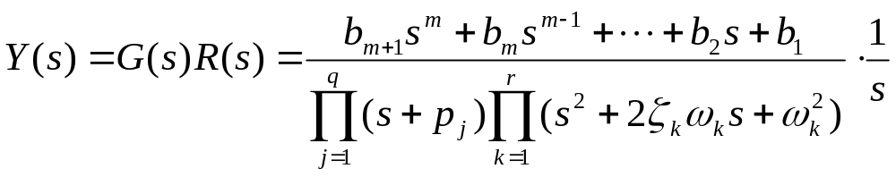
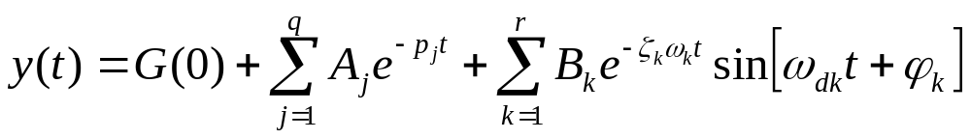
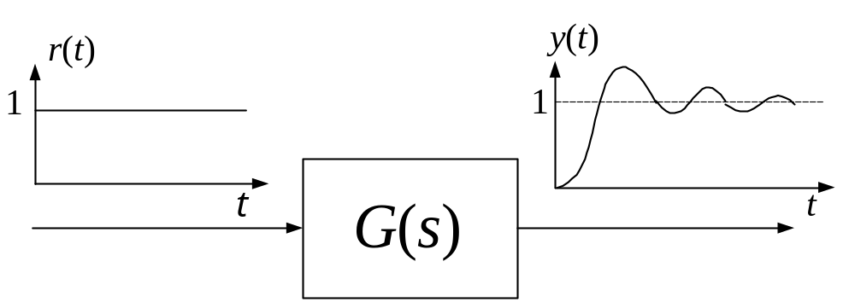
High-order Systems’ Time Response
Laplace transform of the step response of a high-order system
Time response of the system with a step-function as input

Slide 5
High-order Systems’ Time Response
The time response of a high-order system is the linear combination of those of 1st and 2nd order systems;
Poles of a high-order system which is far away from the imaginary axis has less impact on the system’s transient response than those close to the imaginary axis. The farther the distance is, the smaller the impact is.
Zeros of a high-order system also has impact on the system’s time response. They mainly affect the magnitude and phase of a dynamic mode.
The performance of a high-order system is mainly determined by its controlling poles
Controlling Pole
j
ω
−
5
a
−
a
σ
Controlling Pole
Notes:
If a system satisfy the requirement shown in the above figure, it can be simplified into a second order system.

Slide 6
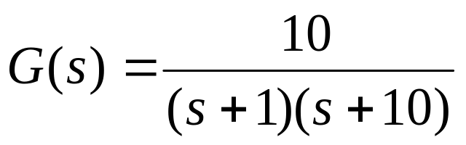
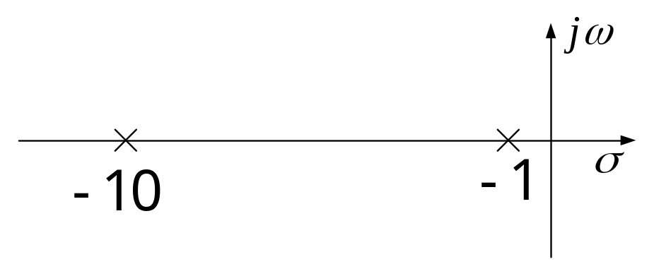
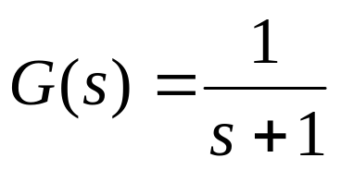
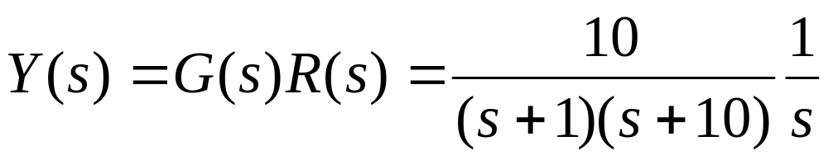
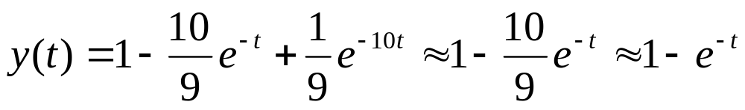
Approximation of High-order Systems by Low-Order Systems
Example:
To keep the final value the same

Slide 7
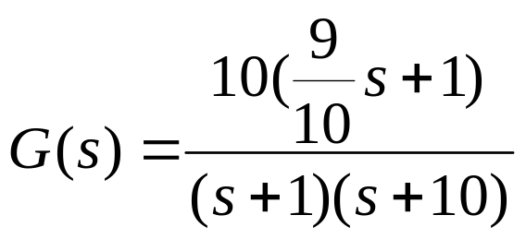
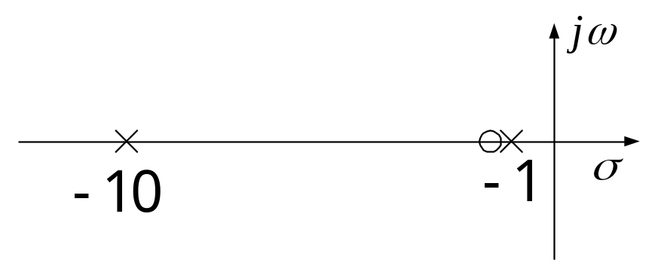
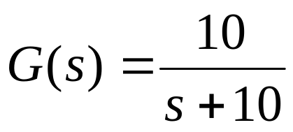
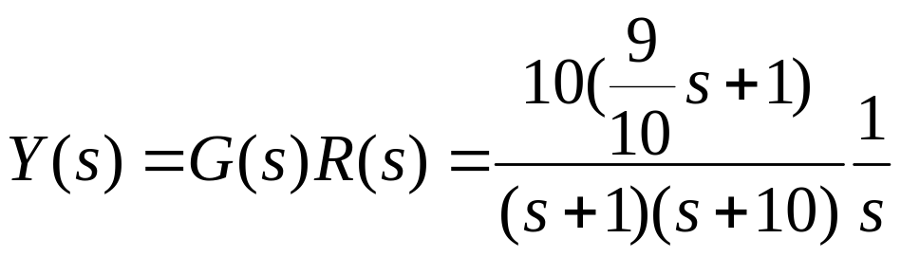
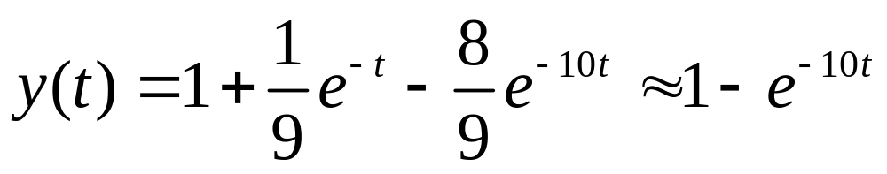
Approximation of High-order Systems by Low-Order Systems
Example:

Slide 8
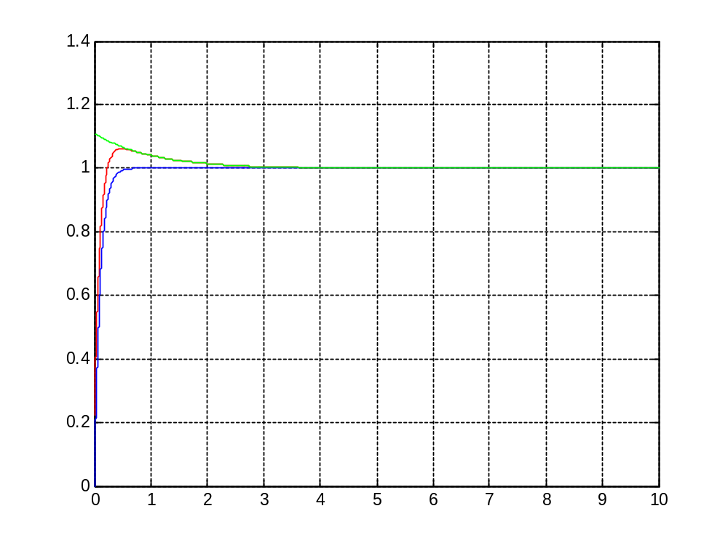
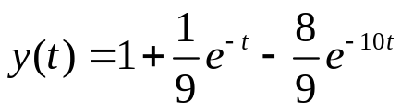

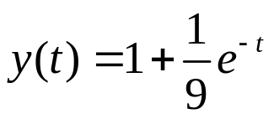
Approximation of High-order Systems by Low-Order Systems

Slide 9


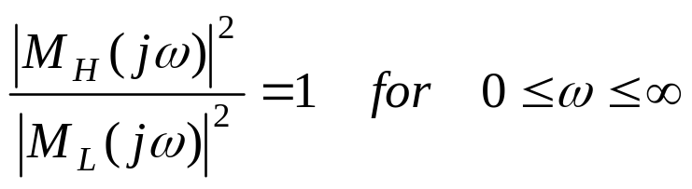

Approximation Criterion
The criterion of finding the low-order
, given
, is that
the following relation should be satisfied as close as possible:
This condition implies that the amplitude characteristics of the two systems
in the frequency domain ( ) are similar.

Slide 10
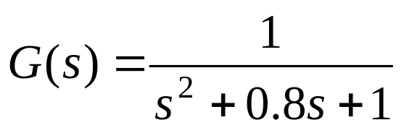
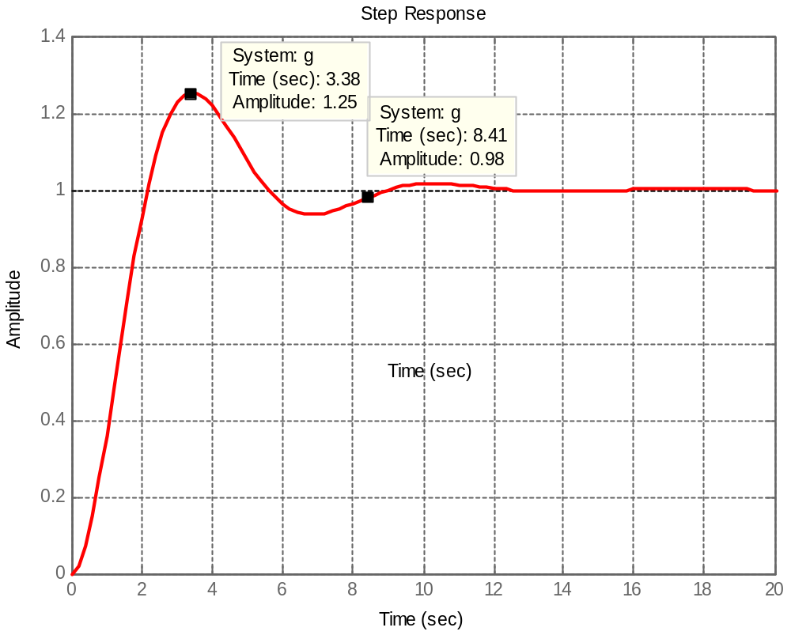
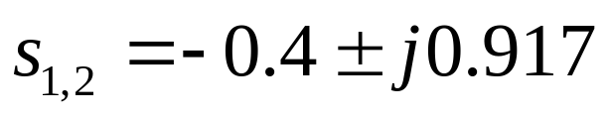

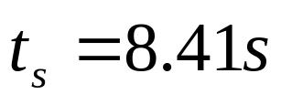
Impact of Additional Poles and Zeros
Original system:

Slide 11
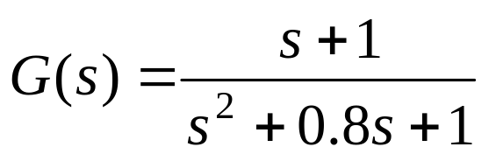
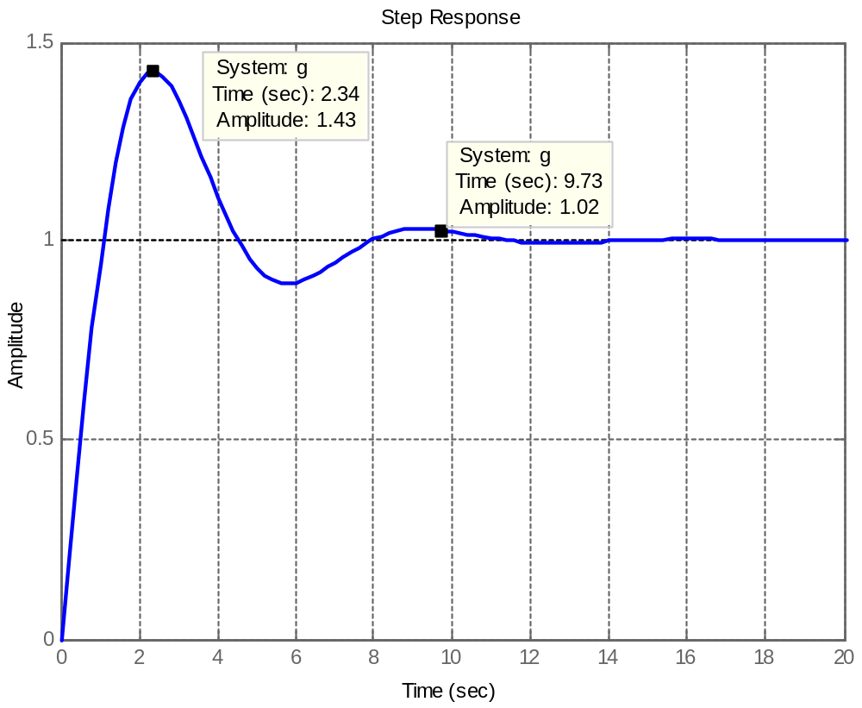

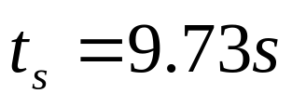
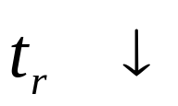
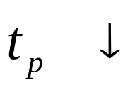
Impact of Additional Zeros
With additional zero:

Slide 12
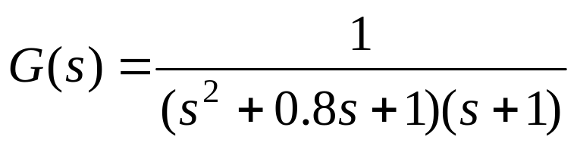
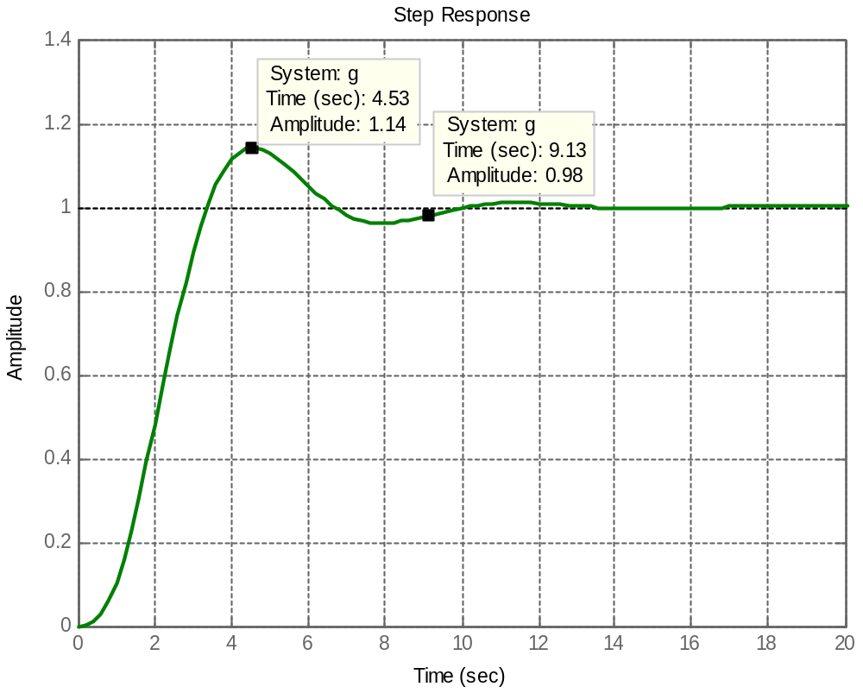

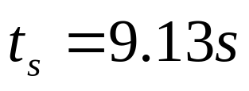
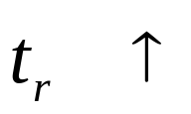
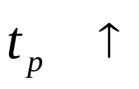
Impact of Additional Poles
With additional pole:

Slide 13
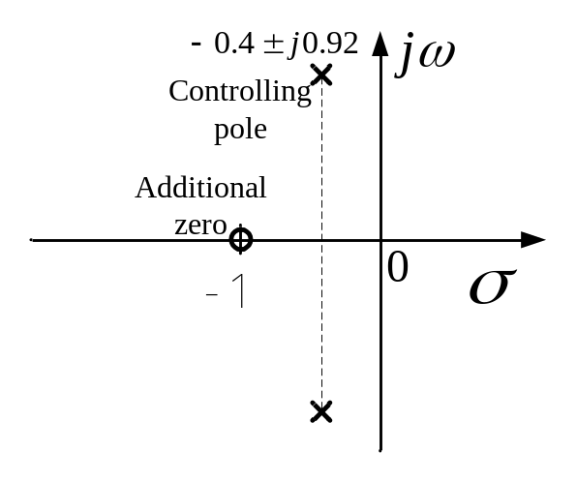
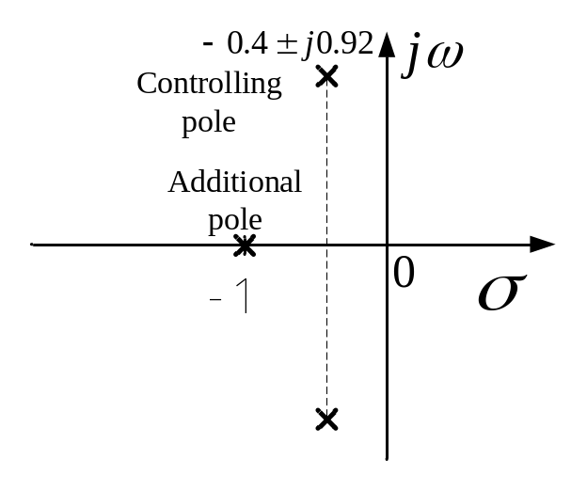
Conclusion on the Impact of Additional Poles and Zeros
y
(
t
)
y
(
t
)
y
1
(
t
)
y
(
t
)
y
(
t
)
y
2
(
t
)
1.0
1.0
Y
(
s
)
=
1
⋅
1
Y
(
s
)
=
1
⋅
1
s
2
+
0
.
8
s
+
1
s
s
2
+
0
.
8
s
+
1
s
Y
(
s
)
=
s
+
1
⋅
1
Y
(
s
)
=
1
⋅
1
1
s
2
+
0
.
8
s
+
1
s
2
(
s
2
+
0
.
8
s
+
1
)(
s
+
1
)
s
0.0
ω
t
0.0
ω
t
0
2
4
6
8
n
0
2
4
6
8
n
Decrease Damping Ratio
Increase Damping Ratio

Slide 14
Next Milestone
Root loci
  Basic concept about root loci;
  Rules for constructing root loci;

Slide 15


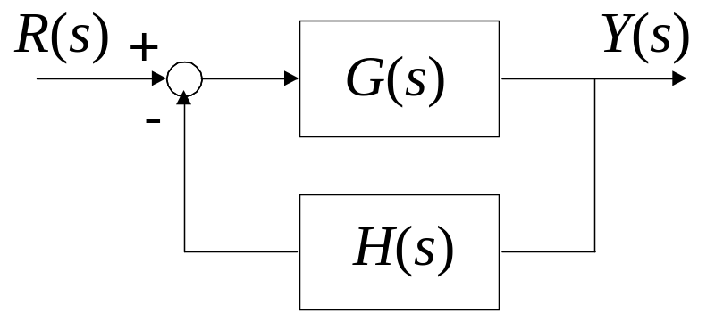
Conditions for Being a Root of Characteristic Equation
R
(
s
)
+
Y
(
s
)
-
H
(
s
)

Slide 16
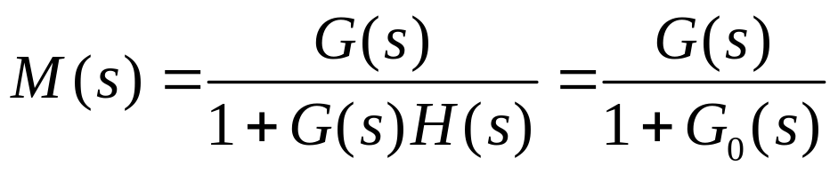
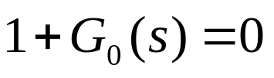

Conditions for Being a Root of Characteristic Equation
Closed-loop TF of the system:
The characteristic equation:
or
Our goal is to comprehend the closed-loop system by analyzing the open loop
system.

Slide 17
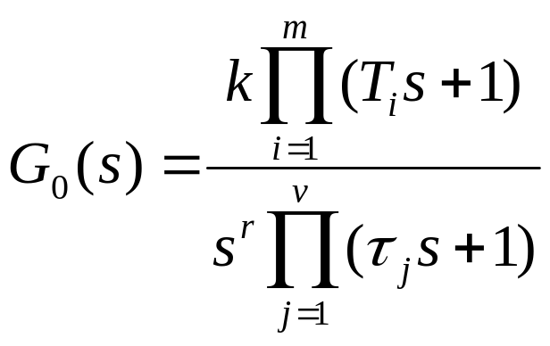

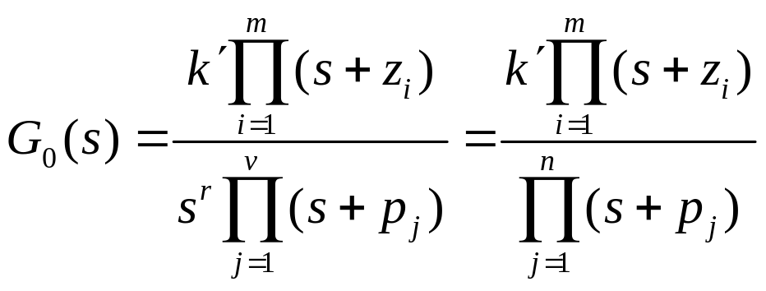
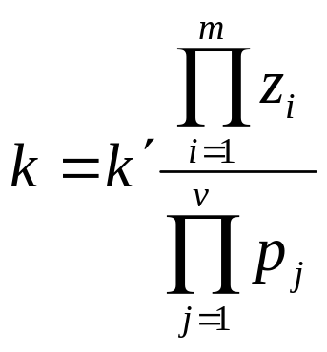
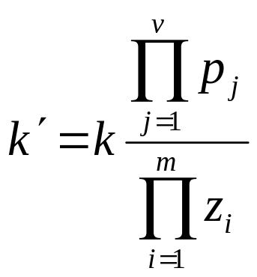
Basic Concepts about Root Locus
Time-Constant form of :
Zero-pole form:
Root locus gain

Slide 18
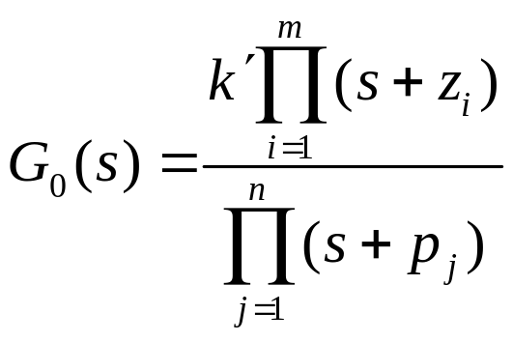
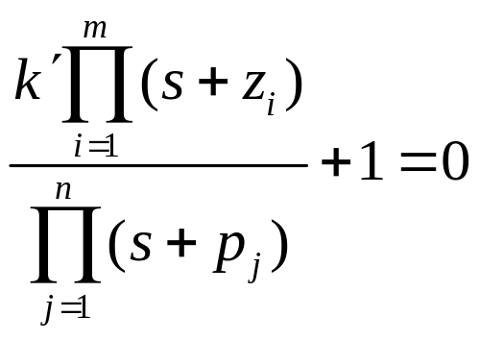






Basic Concepts about Root Locus
What is root loci?
open-loop system
closed-loop system
characteristic
equation
zeros:
poles:
when varies,
and
keep the same
and
change
Root loci are the root trajectories of the closed-loop system when changes

Slide 19
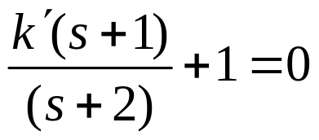
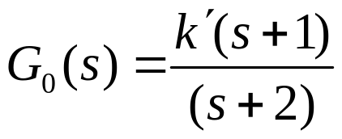
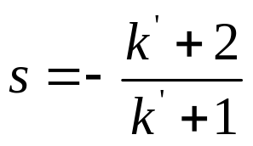


Basic Concepts about Root Locus
An example:
open-loop system
closed-loop system
characteristic
equation
zeros:
poles:
when varies,
and
keep the same
and
change
Root loci are the root trajectories of the closed-loop system when changes

Slide 20
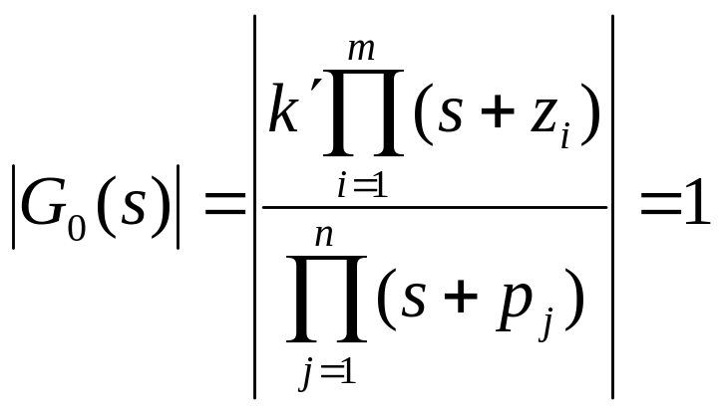
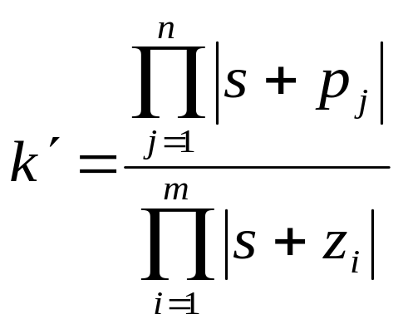
Basic Concepts about Root Locus
Condition on Magnitude:

Slide 21
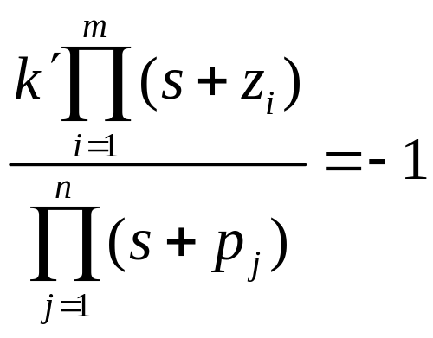
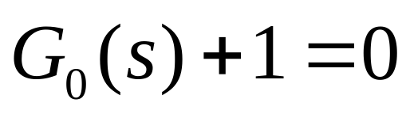
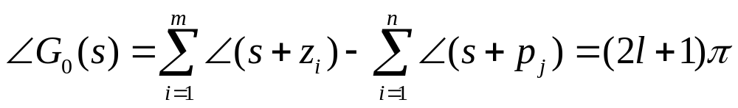
Basic Concepts about Root Locus
Condition on Angle:

Slide 22




Basic Concepts about Root Locus
.
S
j
ω
1
θ
ϕ
ϕ
1
2
1
σ
-
z
-
p
-
p
1
2
1

Slide 23


Remarks
For an n-th order system, one is associated with n characteristic roots; one point on the root locus is associated with a value of .
All the points on the root locus of a system must satisfy the angle condition; all the points that satisfy the angle condition must be on the root locus.
The angle condition is a sufficient and necessary condition
for drawing the root loci.

Slide 24






Example 3.15
Q: Construct the root loci of the system with the following open-loop transfer function
A: rewrite the open loop TF into zero-pole form

Slide 25




j
ω
Trial and error:
Take a point
-p
s
-p
2
1
1
×
•
×
σ
-0.5
-0.1
0
Substitute into the angle condition:
So, is on the root locus.
The root locus gain corresponding to is:
All the points between are on the locus.

Slide 26




Take a point
s
j
ω
•
2
ϕ
ϕ
-p
-p
1
2
×
2
1
×
-0.5
-0.25
0
σ
Substitute into the angle condition:
So, is on the root locus.
The root locus gain corresponding to is:
All the points on the line are on the locus.

Slide 27





Properties and Construction of Root Loci
1. and points
Closed-loop TF of the system:
The characteristic equation:
or
Considering:

Slide 28



Pools of the open-loop TF
Zeros of the open-loop TF
When root locus gain varies from zero to infinity,
the root locus starts from the poles of the open-loop
TF and ends at the zeros of the open-loop TF
Q: how many branches of the root loci do a system have?

Slide 29


Properties and Construction of Root Loci
2. Numbers of Branches on the Root Loci
Closed-loop TF of the system:
The characteristic equation:
or
A branch of the root loci is the locus of one root when varies.
The number of branches of the root loci should be equal to the number of
the roots of the characteristic equation, or the order of the characteristic equation,
or the number of the poles of .

Slide 30



Properties and Construction of Root Loci
3. Asymptotes of the Root Loci
Closed-loop TF of the system:
The characteristic equation:
or
When n, the order of , is not equal to m, the order of , some of
The loci will approach infinity in the s-plane. The properties of the root near
infinity in the s-plane are described by the asymptotes of the loci when

Slide 31




More specifically, if
has n poles and m zeros, the root loci of the system
will have (n-m) asymptotes. At the infinite point, the (n-m) root loci branches
approach the asymptotes unlimitedly.
But where are the asymptotes and where do the asymptotes go? Before we answer this question, we need to understand a concept first – the infinity point.
Infinity

Slide 32





Look at the characteristic equation:
or
Because

Slide 33

At the infinity point, root loci and asymptotes superpose each other. If observing from the infinity point, it seems that the (n-m) asymptotes or root loci branches are from a same point - F.

Slide 34




Comparing the following two equations:
The following relationship holds:
The coordinate of F point, which is the intersect of the asymptotes, is:
on the real axis

Slide 35



At the infinity point, the point on the root loci should also satisfy the angle condition:
General expression of AC:
For point on the asymptotes in the infinity, there are (n-m) angles that start from F
and end at the infinity point. These angles are identical. If we denote the angle by
, then we can get the following equation:

Slide 36
Properties and Construction of Root Loci
4. Symmetry of the Root Loci
The root loci are symmetrical with respect to the real axis of the s-plane.
Why ?
The characteristic equation has real coefficients. The roots must
be real or in complex-conjugate pairs.

Slide 37
Properties and Construction of Root Loci
5. Root Loci on the Real Axis
On a given section of the real axis, root loci are found in the section only if the
total number of poles and zeros of the open-loop TF to the right of the section
is odd.
j
ω
s
•
1
×
×
×
×
σ
What do the complex-conjugate poles and zeros contribute to the angular relation?
What do the real poles and zeros that lie to the right of S₁ contribute?
What do the real poles and zeros that lie to the left of S₁ contribute?

Slide 38








Example 3.16
Q: Construct the root loci of the system with the following open-loop TF.
A: the pole of the open-loop TF is
The number of poles of
The number of zeros of
There is n-m=1 asymptote

Slide 39






Example 3.17
Q: Construct the root loci of the system with the following open-loop TF.
A: the pole of the open-loop TF is
The number of poles of
The number of zeros of
There are n-m=2 asymptotes

Slide 40
Example 3.18
Q: Construct the root loci of the system with the following open-loop TF.
A: the poles of the open-loop TF are
The number of poles of
The number of zeros of
There are n-m=3 asymptotes

Slide 41







Example 3.19
Q: Construct the root loci of the system with the following open-loop TF.
A: the poles of the open-loop TF are
The number of poles of
The number of zeros of
There are n-m=4 asymptotes

Slide 42




Example 3.20
Q: Construct the root loci of the system with the following open-loop TF.
A: the poles and zeros of the open-loop TF
The number of poles of
The number of zeros of
There is n-m=1 asymptote
Breakaway point

Slide 43




Properties and Construction of Root Loci
6. Breakaway Points on the Root Loci
In the previous several cases, we saw two branches of the root loci meet at a
breakaway point on the real axis and they depart from the axis in opposite
direction.
The breakaway point represents a double root of the characteristic equation.
The breakaway points on the root loci of must satisfy:
Where
The above condition is a necessary condition.

Slide 44








Proof : calculate
Because
According to the characteristic equation:
So
Take an increase of ,
Both sides divide ,
We get

Slide 45










If is an n-th order root
Where
so

Slide 46


More words about breakaway points
Another formula used to calculate the coordinate of breakaway points
The angles between branches leaving a breakaway point are determined by

Slide 47





Proof
are coordinates of zeros and poles of the open loof TF
（1）
（2）
The breakaway points are multiple roots, thus

Slide 48






（3）
Rewrite (1) and (2)
（a）
（b）
（4）
P.S.

Slide 49




（5）
P.S.
QED

Slide 50



Properties and Construction of Root Loci
7. Angles of Departure and Arrival
The angle of departure or arrival of a root locus at a pole or zero, respectively,
of denotes the angle of the tangent to the locus near the point.
The angle of departure or arrival of a root locus at a pole or zero of can be determined by assuming a point that is very close to the pole, or zero, and applying the angular condition.
s
•
ϕ
j
ω
1
1
-
p
θ
1
1
-
z
1
θ
σ
2
ϕ
-
p
2
-
z
2
2

Slide 51

Properties and Construction of Root Loci
8. Intersection of the Root Loci with the Imaginary Axis
The points where the root loci intersect the imaginary axis of
the s-plane, if any, and the corresponding values of , may
be determined by means of the Routh-Hurwitz criterion.
That elements of a row are all zeros indicates that one or more
of the following conditions may exist:
  one pair of real roots with equal magnitude but opposite signs;
  one or more pairs of imaginary roots;
  pairs of complex-conjugate roots forming symmetry about the origin of the s-plane.

Slide 52







Example 3.21
Q: Construct the root loci of the following system.
A: the poles of the open-loop TF are
The number of poles of
The number of zeros of
There are n-m=3 asymptotes

Slide 53






Example 3.21 (continue)
Calculate the breakaway point:
is the breakaway point.

Slide 54









Example 3.21 (continue)
Calculate the intersection of the root loci
with the imaginary axis
When
and
that is when
, the system is stable.
When
, the coefficients of
row are all zero.
The auxiliary equation is:
Solve the auxiliary equation:
These are the intersection of the root loci
with the imaginary axis.

Slide 55

How to Use Matlab to Construct the Root Loci
s=tf('s');
g=10/(s*(s+2)*(s+4));
rlocus(g);

Slide 56









Example 3.22
Q: Construct the root loci of the open loop transfer function
A: the open loop transfer function is
So，the poles are
The number of poles
The number of zeros
There are n-m=4 asymptotes

Slide 57







Example 3.22 (continue)
Calculate the breakaway point:
is the breakaway point.

Slide 58






Example 3.22 (continue)
Calculate the intersection of the root loci
with the imaginary axis
When
, the coefficients of
row are all zero.
The auxiliary equation is:
Solve the auxiliary equation:
These are the intersection of the root loci
with the imaginary axis.

Slide 59

How to Use Matlab to Construct the Root Loci
s=tf('s');
m=10/(s*(s+3)*(s^2+2*s+2));
rlocus(m);

Slide 60






Example 3.23
Q: Construct the root loci of the following system.
A: the poles and zero of the open-loop TF are:
The number of poles of
The number of zeros of
There is n-m=1 asymptotes

Slide 61







Example 3.23 (Continue)
The characteristic equation is:

Slide 62



Example 3.23 (Continue)
Calculate the angle of departure

Slide 63






More Examples: Example A
Q: A positive feedback system structure is shown as follows.
Construct the root locus of the system.
Determine the range of the open loop gain to make the system stable and stay overdamped.
Determine the open loop gain and the coordinate of closed-loop pole to make , and calculate the dynamic performance of the system.
+

Slide 64






Example A
Q: 1. Construct the root locus of the system.
+

Slide 65





Intersection point with the imaginary axis

Slide 66



Q2: Determine the range of the open loop gain to make the system stable and stay overdamped.
Q2. Observed from the root locus
Stable:
Overdamped :

Slide 67






Q3: Determine the open loop gain and the coordinate of closed-loop pole to make , and calculate the dynamic performance of the system.
A: Draw the line of from the origin, intersecting the root locus at s_{1.} Let , then the closed-loop characteristic polynomial is
The closed-loop transfer function is
Compare D(s) and Φ(s)

Slide 68







Example B
If the open loop transfer function of a unit feedback system is
Try to draw its closed-loop system root locus, and prove: The complex part of the root locus is a circle whose center is and radius is .
There is n-m=1 asymptotes

Slide 69





Take a point s₁ on the root locus
s₁ should satisfy the closed-loop characteristic equation:
Then we get
So
Eliminate

Slide 70

How to Use Matlab to Construct the Root Loci
s=tf('s');
g=10*(s+2)/(s^2+2*s+3);
rlocus(g);

Slide 71

How to Use Matlab to Construct the Root Loci

Slide 72




How to Use Matlab to Construct the Root Loci

Slide 73
Wrap-up
Transient Response
  Approximation of High-Order Systems
Root loci
  Basic concept about root loci;
  Rules for constructing root loci;

Slide 74
Assignment
Page 73
  Q16
  Q17

